Slide 1
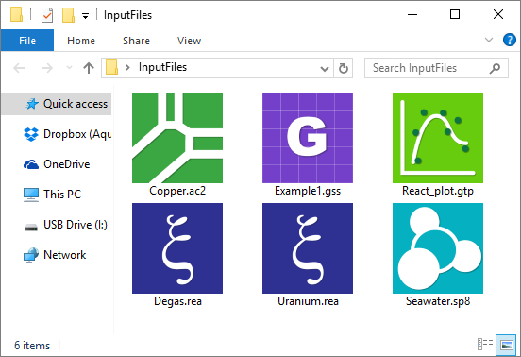
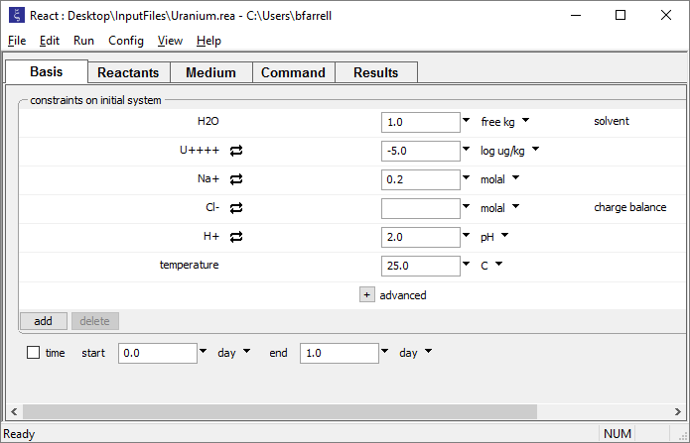

Slide 2
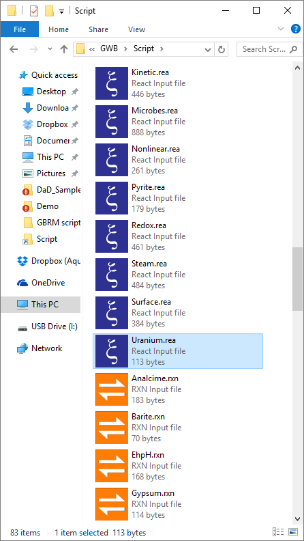
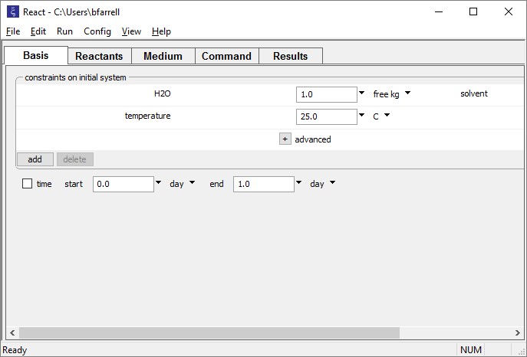
Left-drag input scripts and files into GWB apps

Slide 3
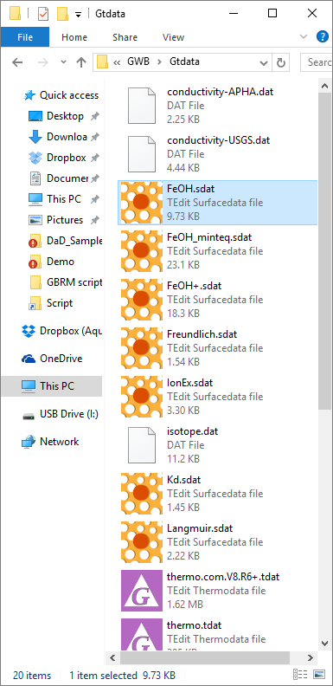
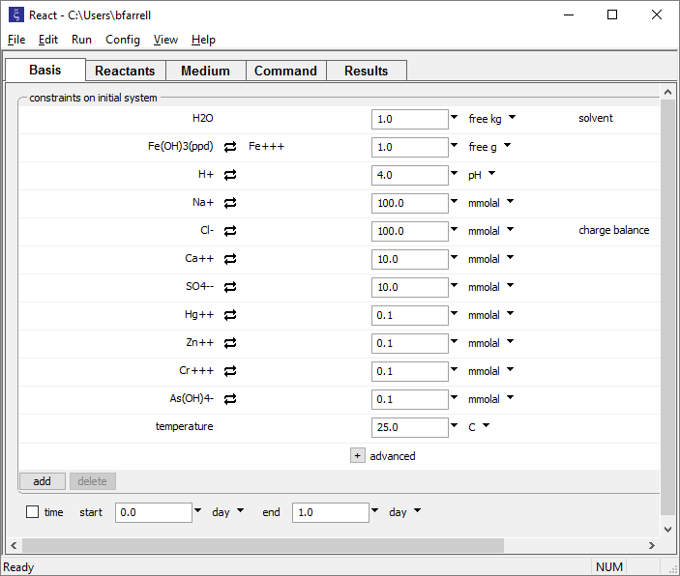
Left-drag thermo and surface reaction datasets into GWB apps

Slide 4
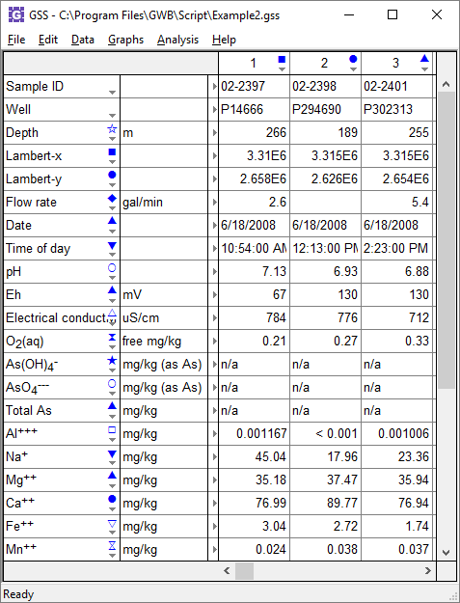
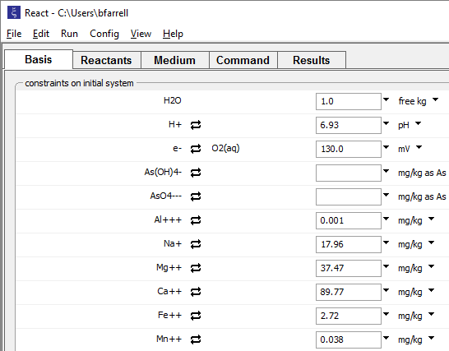
Right-click and hold a sample header, then drag into another GWB app to fill it with that sample’s data.

Slide 5
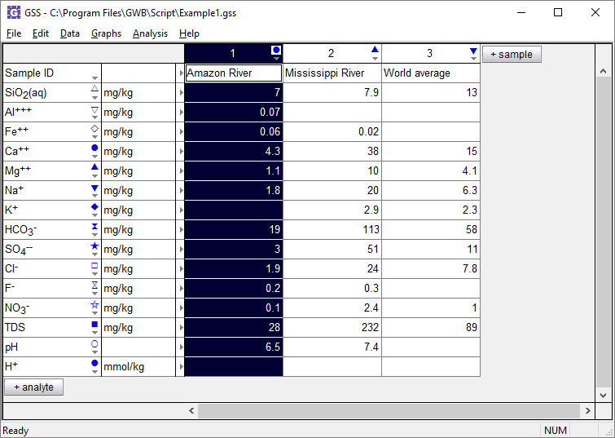
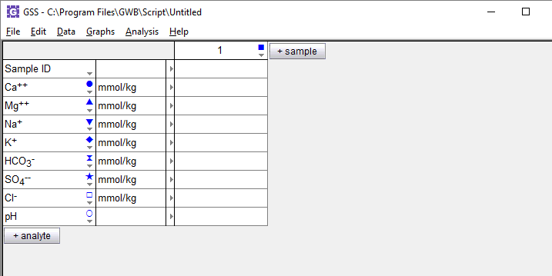
Right-drag samples from one GSS spreadsheet to another.
Fill an existing column…
… or add a new sample

Slide 6
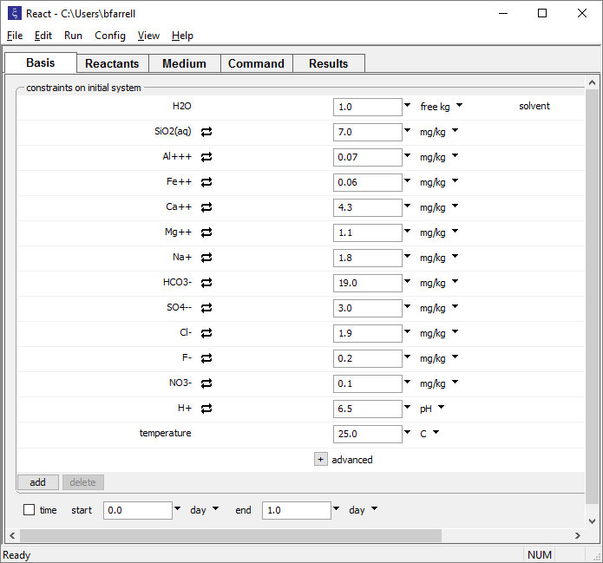
Right-drag pane headers to transfer your Basis, Initial, or Fluids pane data into GSS.
Fill an existing column…
… or add a new sample

Slide 7
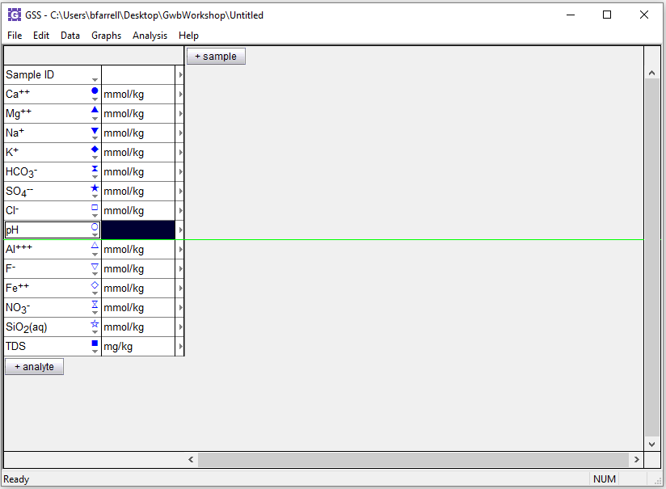
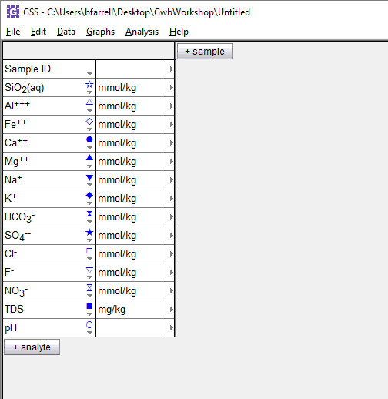
Left-drag an analyte or sample to rearrange within GSS.
Left-drag to reorder your analytes

Slide 8
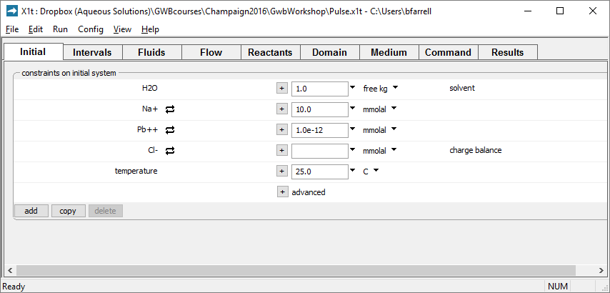
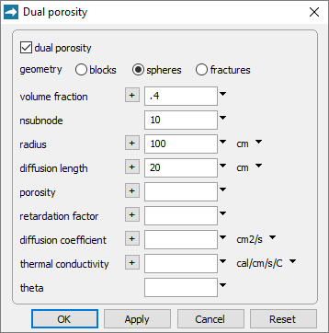
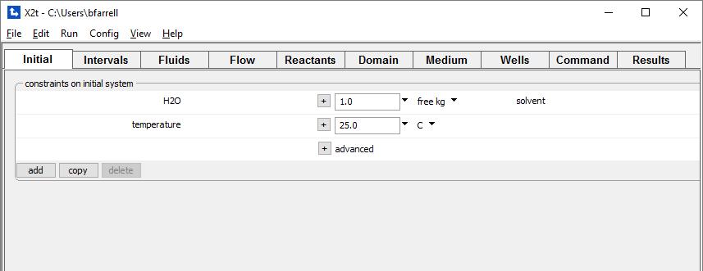
Right-drag dialog box headers to transfer settings from one GWB app to another.
Transfer your Dual porosity settings from X1t to X2t

