Slide 2
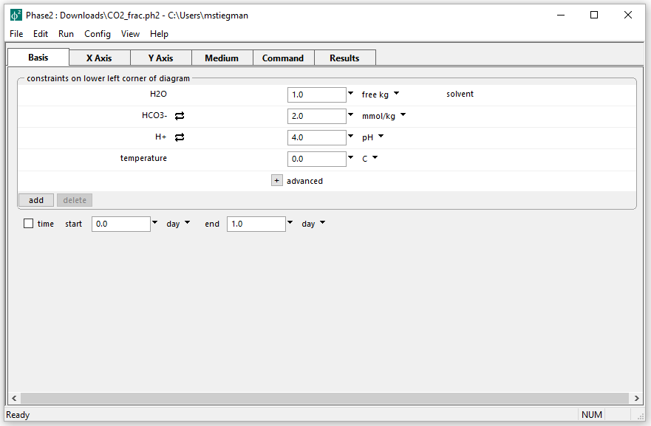
Initial parameters for Isotopic Fractionation diagram
Want to create a diagram of the ¹³C composition of CO2(g) in equilibrium with a carbonate fluid in terms of pH and temperature

Slide 3
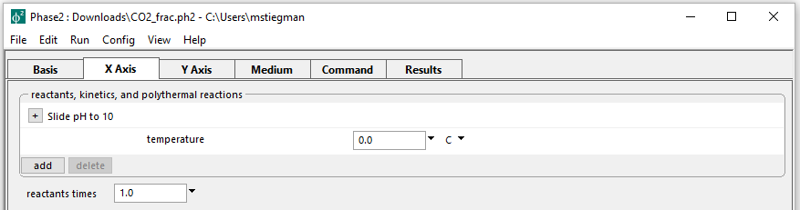
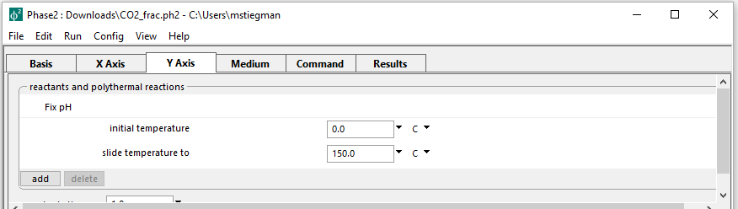
Setting up the staging and scanning paths
Slide the pH to 10 on the X axis
Slide the temperature to 150 ⁰C on the Y axis

Slide 4
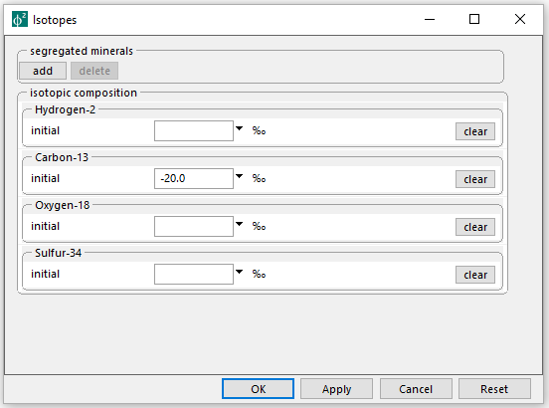
Config → Isotopes…
Set the δ13 C of the fluid to -20‰ PDB
Run → Go → Plot Results

Slide 5
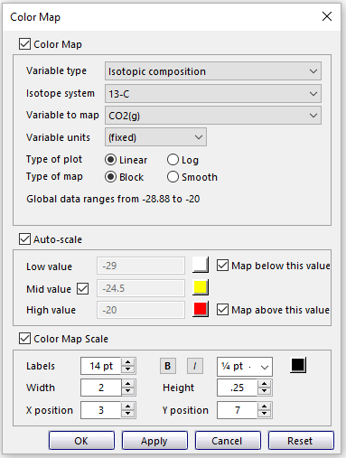
Format → Color Map…
Set Variable type to Isotopic Composition
Set Isotope system to 13-C
Set Variable to map to CO2(g)
Select the same settings for the Color Map window

Slide 6
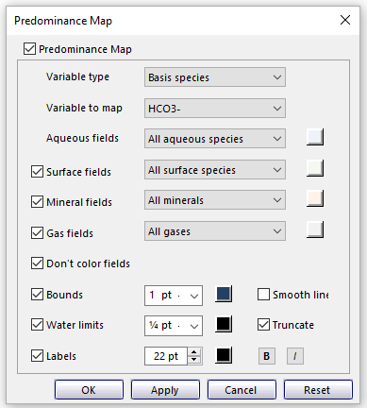
Format → Predominance Map…
Set Variable to map to HCO3-
Allows you to show predominance bounds w/ other plotted data

